Slide 1
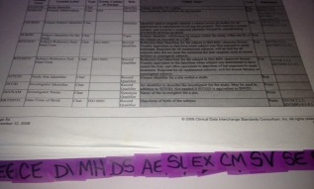
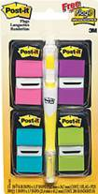
Notes to Instructor
Material Needed
Hard copies of the SDTM IG V3.2 with labelled Post-It notes attached to each domain
Each participant will need to bring their laptop to access workshop templates needed to complete workshop exercises
Excel file Exercise Templates and additional electronic resources on the External SharePoint site

Slide 2
Electronic Documents Required
Lilly Workshop Mod6.pptx (this power point)
Participants will need the following for exercises:
Lilly Mod 6 Exercise.xlsx
Core_SDTM_CM_V2.xlsx
ONC_CRF_SYST3001_V4_exercise.pdf (provide as a hard copy in addition to the electronic copy)
TA_DED_SYST3001_V6 0.xlsx
For Reference:
SDTM IG: Interventions
SDTM v1.4

Slide 3
Lilly Workshop Module 6 SDTM Interventions Domains

Slide 4
Objectives
Encourage participation to enhance learning in this hands-on workshop
Provide an overview of the Interventions Class and key Interventions domains
Participants will be able to determine additional variables to include on a CRF and in the raw data based on an Interventions CRF, DED, and Lilly Standard

Slide 5
Lilly – Data Element Definitions (DEDs)
Notes:
DED section ‘hidden’ in the interest of time. Slide deck is too large to deliver all the content in the allotted amount of time when delivered with Mods 4 and 5 in a single day.

Slide 6
Making Connections
DED
CRF
Standard / SLD
Notes:
Note: Introduction to the concept of metadata.
CDAs are more familiar w/ CRFs and DEDs, not as familiar w/ Standards and SLDs (study level definition).

Slide 7

Reminder of Big Picture Steps
Create Protocol
-1-
2) Write SAP
-2-
3) Input Study Build Design
-3-
4) Choose DEDs/CRF
-4-
Annotate CRF (CRF → Raw)
-5-
Annotate CRF (CRF → SDTM)
-6-
Data Management
-7-
SDTM Study Specs
-8-
SDTM Program & Validate
-9-
ADaM Study Specs
-10-
ADaM Program & Validate
-11-
TFLs and Delivery
-12-
Generate Define.xml
-13-
Clinical Study Report (CSR)
-14-
Submit to FDA
-15-
Notes:
Slide from Mod 1 training.

Slide 8
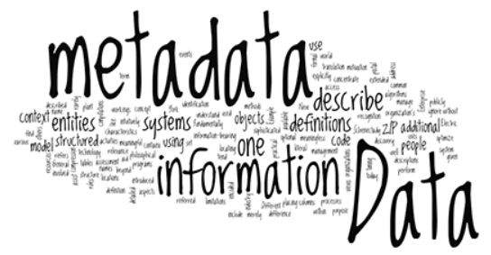
To Understand the Connection
To understand the connection between the CRF, DEDs, and Standards/SLDs, and to complete the next exercise, it will be helpful to have a general understanding of metadata
Metadata = “data about data”
Metadata in the SDTM IG:
Variable Name
Variable Label
Type
CT
Role
Core
Notes:
Introduction to the concept of Metadata.

Slide 9
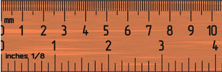
Metadata Not in SDTM IG
Sponsor specific metadata
Metadata needed for programming
Variable Length: LENGTH depends on the values of the data collected. Maximum length is 200 characters. Good practice is NOT to make LENGTH longer than necessary
Programming Algorithm: Description of how variables get mapped, generated, transferred, derived, etc. from RAW dataset to SDTM domains (description must be included in define.xml if variables is derived)
CRF Data
SDTM Domain
DEDs
Notes:
Not all Metadata is in the SDTM IG. Sponsors have their own metadata.

Slide 10

Metadata Not in SDTM IG
Sponsor specific metadata
Metadata needed for define.xml
Origin: Where the source data comes from. For example, “CRF pages 3, 10, 24,” “eDT,” “Derived,” “Assigned,” “Protocol”
Keys: The variables that are used in an SDTM dataset that define uniqueness of the records. For example, in DM the keys are: STUDYID, USUBJID. (one record per subject)

Slide 11
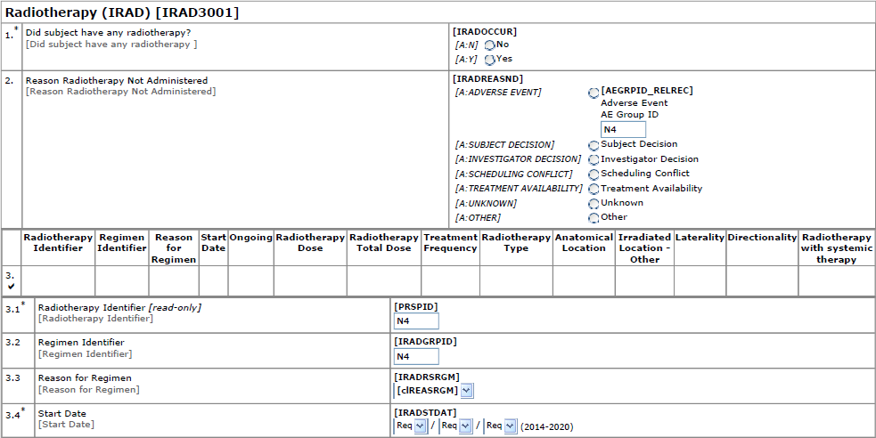
Example Lilly CRF [IRAD3001]
What is the metadata from the SDTM IG?
Variable Names? Variable Labels? Type (Char or Num)? CT (What variables have CT)? Core (Req., Exp., Perm?)
What is the rule or programming algorithm to transform CRF data to SDTM data?
Notes:
Raw data elements need to be mapped to SDTM variables.
Algorithms give you rules and tools to turn the raw data to SDTM vars. These algorithms are one type of sponsor metadata

Slide 12
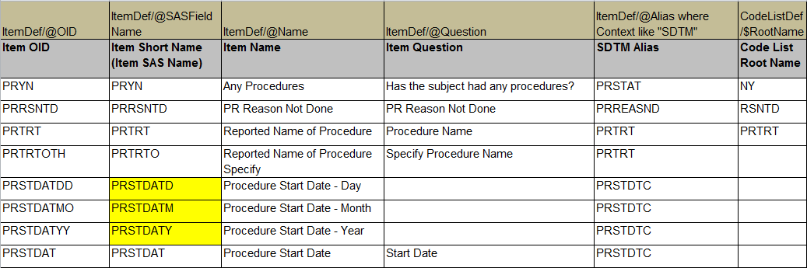
Example Lilly DED (Procedures)
What is the metadata?
Variable Names? Variable Labels? Type (Char or Num)? CT (What variables have CT)? Core (Req., Exp., Perm?)
Length? Programming Algorithm? Source Data (or mapping)?, Origin?
Notes:
Item OID is raw variable name. SDTM Alias is the SDTM variable name
This is one view of the DED. (The Study Build Requirements Visualization)
The next slide presents the tablular visualization.
Lilly DEDs house some of Lilly’s metadata.
Not all vars are SDTM vars: PRYN → PRSTAT (the label in ItemDef may not be correct for SDTM label)

Slide 13
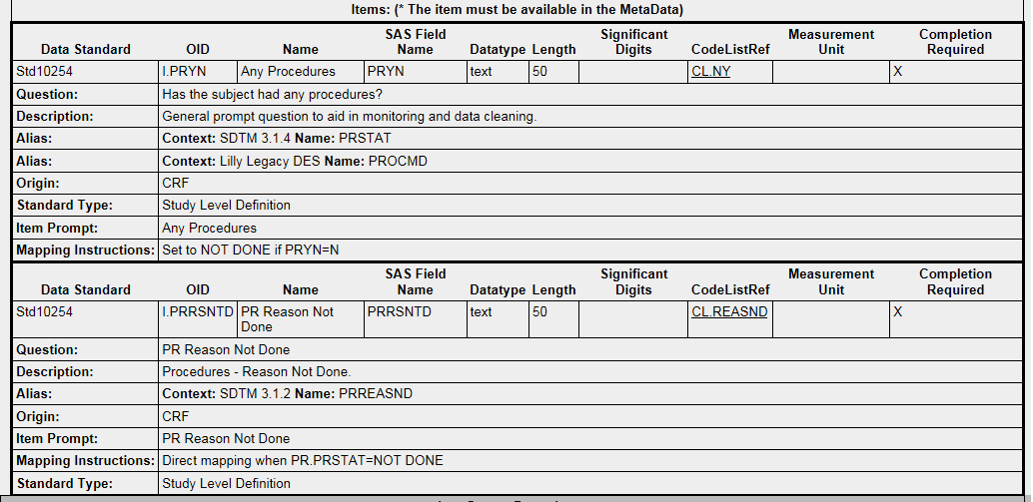
Example Lilly DED (Procedures)
What is the metadata?
Variable Names? Variable Labels? Type (Char or Num)? CT (What variables have CT)? Core (Req., Exp., Perm?)
Length? Programming Algorithm? Source Data (or mapping)?, Origin?

Slide 14
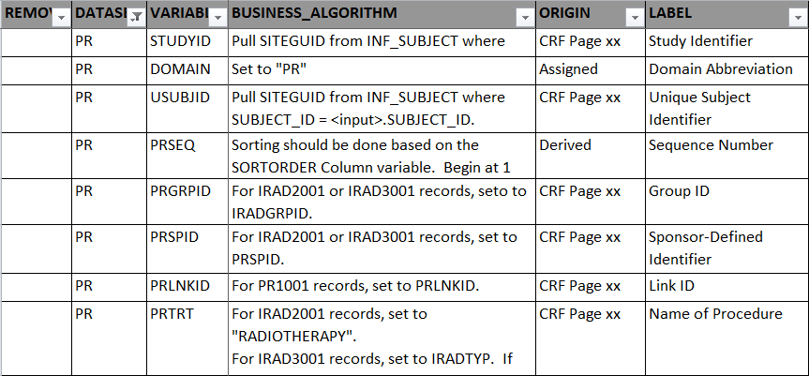
Example Lilly Standard (PR)
What is the metadata?
Variable Names? Variable Labels? Type (Char or Num)? CT (What variables have CT)? Core (Req., Exp., Perm?)
Length? Programming Algorithm? Source Data (or mapping)?, Origin?
Notes:
The Lilly domain standards also house metadata.
Lilly collects ‘Value Required” and “Variable Required’ . These can be used to set core = “Req, Exp, or Perm”

Slide 15
Lilly Module 6 Exercise #1
Notes:
Exercise was removed, part of DED section.
If determined to reinsert this section, the exercise will need to be updated to make it less complicated, or it could be split into 2 separate exercises.

Slide 16
Lilly Mod 6 Exercise #1
Resources:
Use “Lilly Mod 6 Exercise” template (Lilly Mod 6 Ex. 1 tab)
Lilly Substance Use (SU) DED (Core_DED_SU_1001_V6.0_exercise.xls)
Lilly Substance Use SU Standard (Core_SDTM_SU_V2.xlsx)
Exercise:
Determine which Lilly SDTM SU Standard variables can be mapped from the SU DED
Notes:
The point of the exercise is to see where the DEDs and Data Standards fit within the CDA and Stats Job Functions

Slide 17
Exercise #1Step by Step
Open the Lilly Mod 6 Exercise Template, tab: Lilly Mod 6 Ex. 1
Open the Core_DED_SU_1001_V6.0_exercise.xls
Determine which columns correspond to the DED columns below (Columns A-C) and copy the data into the exercise spreadsheet.
Column D: Using the information provided in the SDTM Alias and the Mapping Instructions columns, determine which SDTM variable(s) are mapped from these DED variables (Item OIDs).
Open the Lilly Substance Use SU Standard (Core_SDTM_SU_V2.xlsx)
Column F: Copy the data from the ‘Variable’ column in the Standard into the “Standard Variable” column in the exercise sheet.
Column G: Fill in the “Can You Get this Variable for the DED?” column for each SDTM Variable based on the information you pulled from the DED
Answer on Next Slide

Slide 18
Possible Answer

Slide 19
Interventions Domains

Slide 20
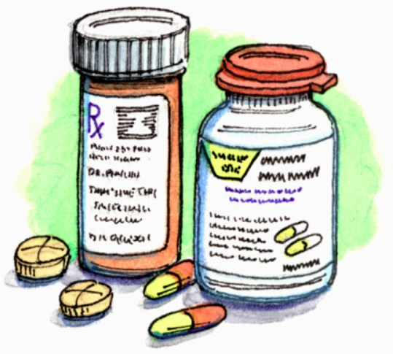
Class: Interventions
Interventions class captures investigational, therapeutic, and other treatments administered to subject either as
specified by the protocol (e.g., exposure to study drug),
coincident with the study assessment period (e.g., concomitant medications), or
self-administered by the subject (such as use of alcohol, tobacco, or caffeine)
Think…“Did something happen to your body”?
CM
Exposure
Exposure as Collected
Procedure
EC
PR
Concomitant and Prior Medications
EX
SU
Substance Use

Slide 21

Interventions and Type of Variables
Open SDTM V1.4, Section 2.1, pages 9-11
Role | Description | Examples
IDENTIFIER | Identify study, subject, domain, and sequence | STUDYID, USUBJID, DOMAIN, xxSEQ
TOPIC | Focus of the observation | xxTRT
QUALIFIER | Additional information to describe the results or traits of the observation | xxMODIFY, xxLLT, xxLLTCD, etc. (see page 9-11 in SDTM V1.4)

Slide 22
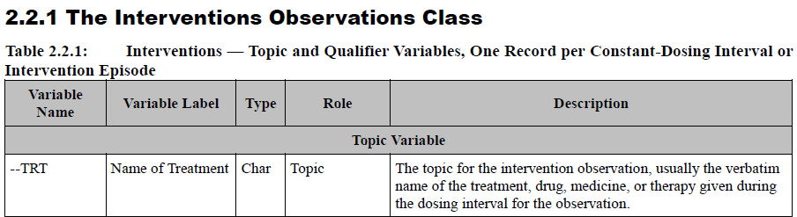
Interventions: xxTRT
INTERVENTIONS domains contain the TOPIC variable xxTRT (e.g., CMTRT, EXTRT, etc.)
Other variable Roles in an INTERVENTIONS domain include: identifiers, timing, and qualifiers
Notes:
Discuss that all interventions domain have a xxTRT variable. This is akin to the Findings Topic variable xxTESTCD. Ask trainees what other xxTRT variables there are (tell them to thing about the preceding slides: SUTRT, ECTRT, PRTRT

Slide 23
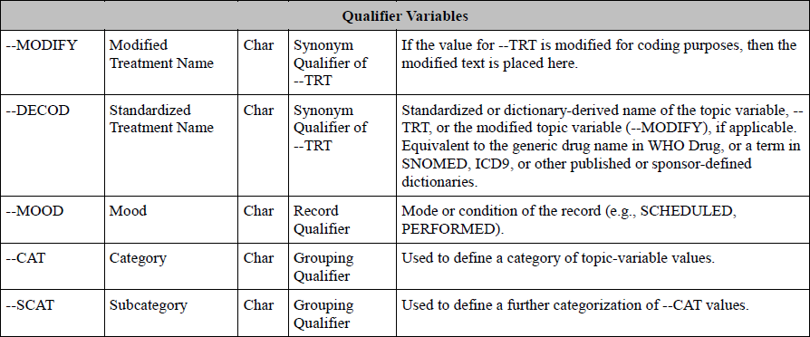
Interventions Qualifiers
--DECOD in INTERVENTIONs domains differs from --DECOD in EVENTs domains
Coding dictionaries differ (e.g., WHO Drug vs. MedDRA)
Notes:
Slide hidden as EVENTs domain not covered prior to this Module.

Slide 24
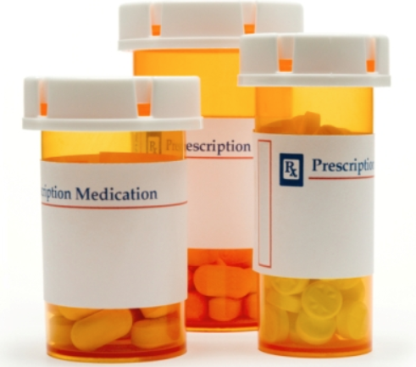
Interventions Variables
SDTM v1.4 (p. 9-11) includes all possible INTERVENTIONS variables
Do NOT include every possible INTERVENTION variable is every INTERVENTIONS domain!
Use the SDTM IG V3.2 in conjunction with the SDTM v1.4 to determine the Interventions variables needed for each Interventions domain
CM: Concomitant and Prior Medications
EX: Exposure
EC: Exposure as Collected
PR: Procedures
SU: Substance Use
Notes:
Open SDTM model to let students know that all variables in model are allowed in Interventions domain, unless specifically disqualified for use in the IG.
At Lilly, this has already been done, and the Lilly allowed variables by domain are housed in the Standards.

Slide 25
Closer Look at Some Interventions Domains

Slide 26
Concomitant Medications (CM)
CM may contain concomitant medications as well as prior medications and therapies
CM Structure: One record per recorded medication occurrence or constant-dosing interval per subject
Keys (makes a unique record): STUDYID, USUBJID, CMTRT, CMSTDTC
STUDYID | USUBJID | CMTRT | CMSTDTC
ABC123 | ABC123-001-10001 | ASPIRIN | 2013-01-15
ABC123 | ABC123-001-10001 | ASPIRIN | 2013-01
Notes:
The KEYS is just an example. Additional variables may be required to create unique records.

Slide 27
Pre-Specified on CRF
Pre-Specified: If the medication/therapy is pre-specified on the CRF, then use the variables for
“Pre-specified” on the CRF, CMPRESP
“Occurrence” CMOCCUR together
Both of these variable use the controlled terminology (NY)
USUBJID | CMTRT | CMPRESP | CMOCCUR
ABC123-001-00002 | Advil | Y | Y
ABC123-001-00003 | Advil | Y | N
Notes:
Stress that these are used together for Prespecified meds on a CRF. You do not use xxOCCUR w/out xxPRESP. They are ‘paired’ variables. Ask students if they remember any other paired variables: VISIT/VISITNUM, xxTEST/xxTESTCD

Slide 28
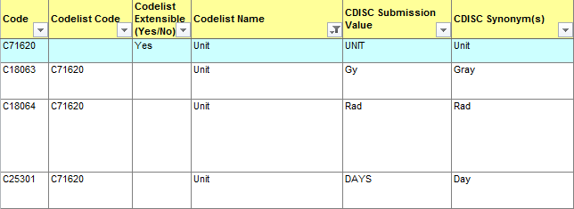
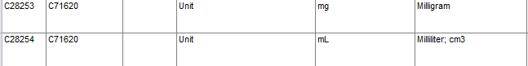
CM Units
CM variable “Dose Units” CMDOSU uses CT (UNIT). Notice the casing of units
It would be incorrect to record CMDOSU = “ml” for example.
It would be incorrect to record CMDOSU = “Milliliter”
CMDOSU = “mL” is correct
Notes:
This is a review of use of CT as it applies to CM. The point to be stressed is that the casing of the value must be the same as the CT.

Slide 29
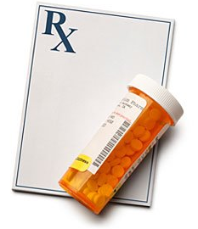
Exposure Domains (EX and EC)
Exposure (EX): The Exposure domain model records the details of a subject's exposure to protocol-specified study treatment
The EX domain is recognized in most cases as a derived dataset where EXDOSU reflects the protocol-specified unit per study treatment
Exposure as Collected (EC): The Exposure as Collected domain model reflects protocol-specified study treatment administrations, as collected
Notes:
EC contains the data captured on the CRF, EX contains the exposure data as calculated per the protocol specified units. If the CRF captures the data in the protocol specified units, EC may not be needed.
Note: EC is new per SDTM IG 3.2.

Slide 30
Exposure Example: Raw Data
Exposure data can be very complex (and beyond the scope of this workshop)
Example CRFs below
Three injections from a single subject (USUBJID = ABC3001)
Protocol-specified dose = 3 mg/kg
Assume 3 injections equates to a single administration of study drug
INJECTION | #1
Volume Given (mL) | 5
Location | ABDOMEN
Side | LEFT
INJECTION | #2
Volume Given (mL) | 5
Location | ABDOMEN
Side | CENTER
INJECTION | #3
Volume Given (mL) | 4.75
Location | ABDOMEN
Side | RIGHT
Notes:
Walk through the information provided on this slide. This is the data captured on the CRF. The next 2 slides will show how this data is mapped to EC and EX.

Slide 31
Exposure Example: SDTM Data
EC: Show the collected administration amounts (mL) associated with their respective locations
EX: Show the calculated administration in protocol-specific unit (mg/kg). Sponsor considers 3 injections as a single administration. Subjects weight was 100 kg. Concentration is 20 mg/mL
Derivation of EXDOSE/EXDOSU:
14.75mL x 20mg/mL = 295 mg divide by 100kg subject weight = 2.95 mg/kg
USUBJID | ECSPID | ECTRT | ECDOSE | ECDOSU | ECLOC | ECDOSFM | ECLAT
ABC3001 | 1 | DRUG X | 5 | mL | ABDOMEN | INJECTION | LEFT
ABC3001 | 2 | DRUG X | 5 | mL | ABDOMEN | INJECTION | CENTER
ABC3001 | 3 | DRUG X | 4.75 | mL | ABDOMEN | INJECTION | RIGHT
USUBJID | EXTRT | EXDOSE | EXDOSU | EXLOC | EXDOSFRM
ABC3001 | DRUG X | 2.95 | mg/kg | ABDOMEN | INJECTION

Slide 32
Intervention Variables Not in EX
Intervention Variables Generally Not Used in EX:
Pre-specified: xxPRESP
Occurrence: xxOCCUR
Not Done: xxSTAT
Reason Not None: xxREASND
Test Yourself:
Why are these variables not ordinarily included in the Exposure (EX) domain?
Which of the above variables might be included in EC?
Notes:
Answer:
Per the IG some variables are not recommended for use in EX.
EX contains data for study medications received. EX does not contain data for drug not given (like AE only contains AEs that occurred).
Note:
EC captures Doses Not Taken, Not Given, or Missed in the ECOCCUR variable. ECSTAT and EXREASND are generally not used in EC per the IG. Reason for Missed, Not Given, etc. would be mapped to SUPPEC as Reason for ECOCCUR Value.

Slide 33
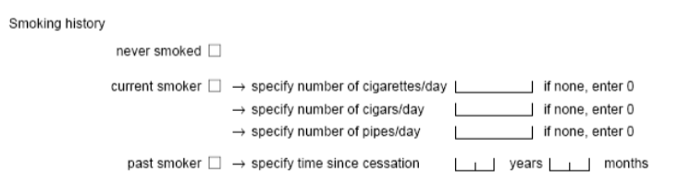
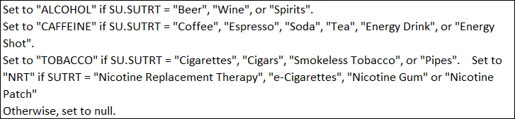
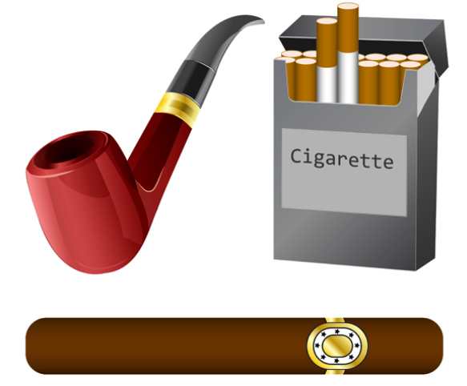
Substance Use (SU)
The intent of this domain is to capture substance use information that may be used to assess the efficacy and/or safety of therapies that look to mitigate the effects of chronic substance use, or that could be used as covariates in other efficacy and/or safety analysis.
SUCAT = Category for Substance Use
SUCAT = “TOBACCO”
SUTRT= Reported Name of Substance
SUTRT = “Cigarettes”
SUTRT = “Cigars”
SUTRT = “Pipes”
Notes:
Example: Monitoring of caffeine use in an insomnia study. Affects of alcohol on liver function, etc. Note xxCAT used in both Interventions and Findings. ….Some variables used in all Observation classes

Slide 34
Lilly Module 6 Exercise #1

Slide 35
Lilly Mod 6 Exercise #1
Resources:
Use “Lilly Mod 6 Exercise” template (Lilly Mod 6 Ex. 1 tab)
Lilly CRF (ONC_CRF_SYST3001_V4_exercise.pdf)
Lilly DED (TA-DED_SYST3001_V6 0.xls)
Lilly CM Standard (Core_SDTM_CM_V2.xlsx)
Exercise:
Based on the Lilly [SYST3001] CRF and the DED,
Determine which Lilly Required variables are collected on the CRF
Notes:
Have students go to SharePoint and open Wave 2 Mod 6 if they haven’t already done so.

Slide 36
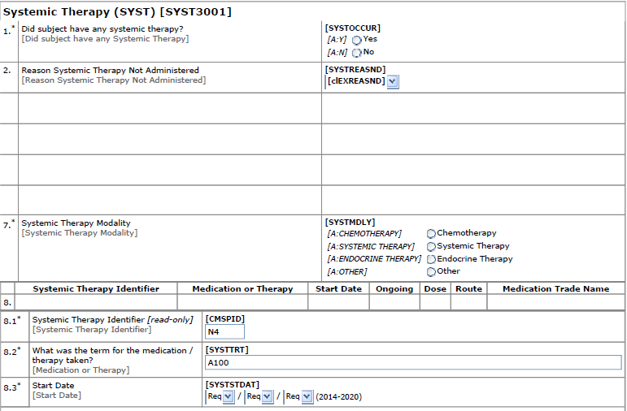
Lilly Systemic Therapy CRF [SYST3001_V4_exercise]
Notes:
Screen shot of the hard copy CRF they will use for this exercise.
Note: This CRF has been modified from the original to only contain a subset of the variables.

Slide 37
Exercise #1 –Step by Step
Open the Lilly Mod 6 Exercise Template, tab: Lilly Mod 6 Ex. 1
Open the “ONC_CRF_SYST3001_V4_exercise.pdf” CRF or use the hard copy provided
Column CRF Variables: Enter the variables that are on the CRF - verbatim
Open the DED “TA-DED_SYST3001_V6 0.xls”
Column DED/SDTM Alias: Based on column CRF Variables, use the DED to map the CRF variables to SDTM variables (Hint, column Item OID = CRF Variable and SDTM Alias = SDTM Variable)
Open the Lilly CM Standard “Core_SDTM_CM_V2.xlsx”
Determine which variables are Required per Lilly (Hint, use column “Variable Required”)
Lilly SDTM Column: Copy all Lilly required variables from CM Standard
On CRF/ Not on CRF Columns: List the Lilly Required Variables that are captured on the CRF, and those that are NOT captured on the CRF.
Advance to Answer
Notes:
For CDAs go to the next slide and do the first one together.
Leave this slide up on the screen while trainees go through the exercise.
Read through the instructions slowly, and walk around the room monitoring progress and providing help.

Slide 38
Getting Started: First Variable
CRF

Slide 39
Getting Started: First Variable
CRF

Slide 40
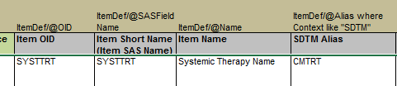
Getting Started: First Variable
CRF
DED

Slide 41
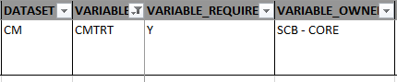
Getting Started: First Variable
CRF
DED
Lilly CM Standard

Slide 42
Getting Started: First Variable
CRF
DED
Lilly CM Standard
Is the variable in “Lilly Required” on the CRF or not on the CRF?
Enter the variable into one of the last 2 columns depending on the answer.

Slide 43
Getting Started: First Variable
CRF
DED
Lilly CM Standard
Continue entering the CRF variables from the CRF and all the Lilly SDTM Required
variables per the Lilly Standard.

Slide 44
Exercise #1 –Step by Step
Open the Lilly Mod 6 Exercise Template, tab: Lilly Mod 6 Ex. 1
Open the “ONC_CRF_SYST3001_V4_exercise.pdf” CRF or use the hard copy provided
Column CRF Variables: Enter the variables that are on the CRF - verbatim
Open the DED “TA-DED_SYST3001_V6 0.xls”
Column DED/SDTM Alias: Based on column CRF Variables, use the DED to map the CRF variables to SDTM variables (Hint, column Item OID = CRF Variable and SDTM Alias = SDTM Variable)
Open the Lilly CM Standard “Core_SDTM_CM_V2.xlsx”
Determine which variables are Required per Lilly (Hint, use column “Variable Required”)
Lilly SDTM Column: Copy all Lilly required variables from CM Standard
On CRF/ Not on CRF Columns: List the Lilly Required Variables that are captured on the CRF, and those that are NOT captured on the CRF.
Advance to Answer
Notes:
For CDAs go to the next slide and do the first one together.
Leave this slide up on the screen while trainees go through the exercise.
Read through the instructions slowly, and walk around the room monitoring progress and providing help.

Slide 45
Possible Answer
Return to Instructions
Notes:
Yellow – Lilly required
Peach- Permissible variables per Lilly that are on the CRF
Review answers. See if students came up with any alternative answers.
Note: There is a typo in the DED as of 16Mar2015: TA_DED_SYST3001_v6.0. CMDOSEU should be CMDOSU per SDTM IG. Notify Lilly SME

Slide 46
Lilly Module 6 Exercise #2
Notes:
Exercise 2 may be skipped if delivering more than 3 mods in one day.

Slide 47
Lilly Mod 6 Exercise #2
Resources:
Use “Lilly Mod 6 Exercise” template (Lilly Mod 6 Ex. 2 tab)
Lilly DED (TA-DED_SYST3001_V6 0.xls)
Exercise:
This Exercise Builds on the last Exercise. We will determine which SDTM variables should be added to the CRF
Based on the answers from Exercise 1, which have been copied into tab Ex 2:
Determine the additional variables to include on the CRF

Slide 48
Exercise # 2 –Step by Step
Open the Lilly Mod 6 Exercise Template, tab: Lilly Mod 6 Ex. 2
Use the information provided in Columns A-F, or copy your answers from Exercise 1
Open the DED “TA-DED_SYST3001_V6 0.xls”
Column G: Use the DED column “SDTM Alias” to copy ALL the SDTM variables held in the DED (this is similar to the previous exercise)
Remove variables that reference “SUPPxx.QVAL or [NOT SUBMITTED]
Compare Columns E (Required Variables not on CRF) and G (DED/CRF variables) .
Column H: determine which Lilly Required variables need be added to the CRF
Column I: determine the Lilly Required variables that will not have the CRF as the source
Advance to Answer
Notes:
This exercise builds on the previous exercise. The purpose is to use the DED and Standard information to determine which Lilly SDTM Required variables need to be added to the CRF, and which SDTM variables will have a source that is not the CM CRF.

Slide 49
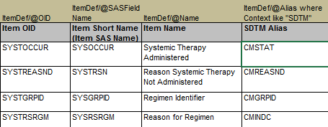
Getting Started
DED

Slide 50
Getting Started
DED

Slide 51
Getting Started
DED
?

Slide 52
Getting Started
DED
Is STUDYID a variable in the DED?
No, so variable will have data that has a source that is not this CRF

Slide 53
Getting Started
DED
Is STUDYID a variable in the DED?
No, so variable will have data that has a source that is not this CRF

Slide 54
Getting Started
DED
Is STUDYID a variable in the DED?
No, so variable will have data that has a source that is not this CRF
Is CMINDC a variable in the DED?
Yes, so this variable should be added to the CRF

Slide 55
Getting Started
DED
Is STUDYID a variable in the DED?
No, so variable will have data that has a source that is not this CRF
Is CMINDC a variable in the DED?
Yes, so this variable should be added to the CRF

Slide 56
Exercise # 2 –Step by Step
Open the Lilly Mod 6 Exercise Template, tab: Lilly Mod 6 Ex. 2
Use the information provided in Columns A-F, or copy your answers from Exercise 1
Open the DED “TA-DED_SYST3001_V6 0.xls”
Column G: Use the DED column “SDTM Alias” to copy ALL the SDTM variables held in the DED (this is similar to the previous exercise)
Remove variables that reference “SUPPxx.QVAL or [NOT SUBMITTED]
Compare Columns E (Required Variables not on CRF) and G (DED/CRF variables) .
Column H: determine which Lilly Required variables need be added to the CRF
Column I: determine the Lilly Required variables that will not have the CRF as the source

Slide 57
Possible Answer
Return to Instructions
Notes:
Peach = required not on CRF
Yellow = required but missing from CRF (they should be added)
Review vars to be added to CRF, vars that will have a different source: some derived/calculated, (--DY) some created (CMSEQ), and some assigned (DOMAIN). This can serve as a brief into to the concept of Origin which will be covered in the define.xml training.

Slide 58
Summary
Interventions class captures investigational, therapeutic, and other treatments administered to subject either as specified by the protocol, coincident with the study assessment period, or self-administered by the subject
Interventions CRFs must collect a treatment topic variable, xxTRT, and other Req., Exp., and Perm. variables to support the metadata in the Lilly Standards
The DEDs provide information that links the CRF variables to their SDTM variable counterparts

Slide 59
End of Lilly Module 6 ☺

